Slide 1
Global CO2 levels
CO2 Emissions from 1960 to 2012
Presented by Manana Mokgoera
Modified: 15 July 2025

Slide 2
Table of contents
Introduction
The CO2 production
The CO2 production per capita
Conclusion

Slide 3

Intro
The CO2 levels has risen over the years; we are going to discover how much CO2 is emitted and which regions have contributed to this rise.

Slide 4
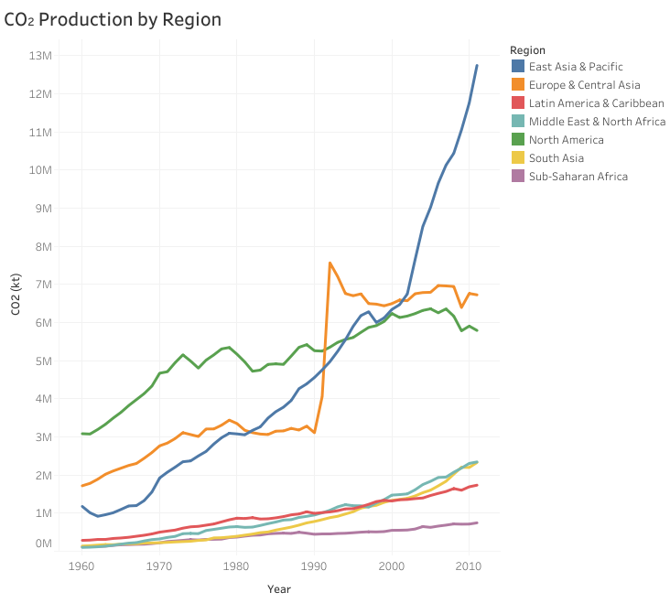


CO2 production
The emission of CO2 has risen over the years in various regions in the Northren Hemisphere
The change at East Asia & Pacific region from around 1998.
The drastic change for the Europe & Central Asia region in 1990.

Slide 5
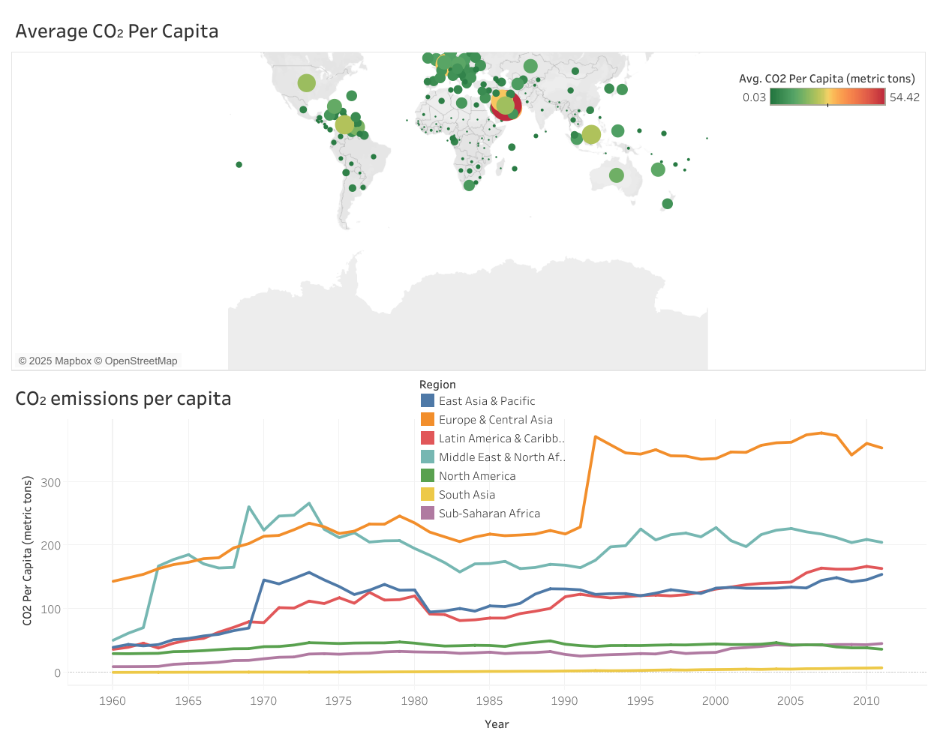
CO2 production per capita
The map shows the average emission of CO2 per capita and Europe & Central Asia is the biggest contributor, emitting over 300kiloton of CO2 since around 1991.

Slide 6
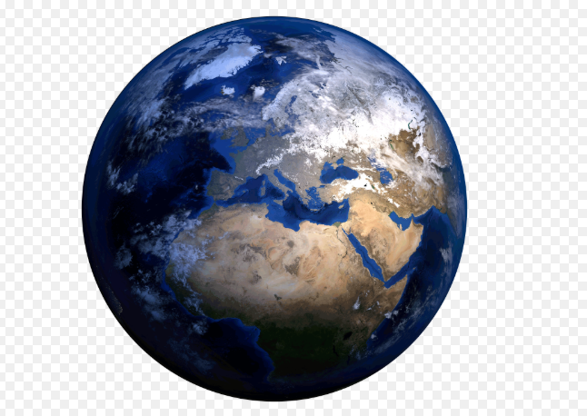
Conclusion
As evidence suggests, the well developed countries and those that have sustained economic growth tend to have higher CO2 emissions.

